Slide 1
NLP Practical Exam
Sentiment Analysis & Topic Clustering
NAME: Kato Joseph Bwanika
BSc. Computer Science
Reg. No: 2023-B291-11709
Lecturer: Dr. Sibitenda Harriet
Supervisor: Dr. Harriet Sibitenda | BSc. Computer Science | Uganda Martyrs University, Nkozi | 2026

Slide 2
Background & Motivation
Large volumes of text are generated daily from:
Social media platforms
Online news articles
This data is unstructured, making manual analysis difficult.
Natural Language Processing (NLP) enables:
Automated text understanding
Pattern discovery
Insight generation
This project demonstrates a complete NLP pipeline applied to real-world datasets.

Slide 3
Objectives
Main Goals
Build an end-to-end NLP pipeline
Perform sentiment classification of tweets
Automatically discover topics in news articles
Evaluate models and interpret results
Two major tracks were implemented:
Track 1: Sentiment Analysis (Supervised Learning)
Track 2: Topic Clustering (Unsupervised Learning)
01
2.5

Slide 4
NLP Pipeline Overview
The workflow followed a structured pipeline:
Data loading & exploration
Text preprocessing & cleaning
NLP exploration (word frequency & bigrams)
Feature engineering using TF-IDF
Machine learning modelling
Clustering & visualization
Evaluation and interpretation

Slide 5
1. SENTIMENT ANALYSIS
Dataset Understanding
Dataset used: Sentiment140 Tweets
Key tasks performed:
Loaded dataset using pandas
Identified key columns (tweet text & sentiment)
Computed dataset statistics
Observation: Tweets are short, informal and contain noise such as URLs and hashtags.

Slide 6
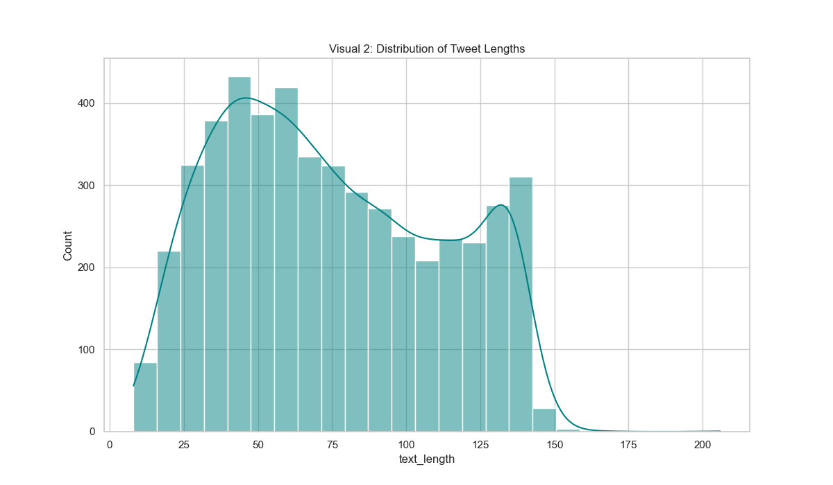
Tweet Length Distribution
Python / Flask
Interpretation
Majority of tweets are short texts
Short texts require strong preprocessing and feature engineering
Highlights challenges of social media NLP.

Slide 7
Text Preprocessing
Noise identified in tweets:
URLs and mentions
Hashtags and punctuation
Stopwords and informal expressions
Cleaning techniques used:
Regex cleaning
Tokenization (NLTK)
Stopword removal
Lemmatization
Result → Clean, normalized text ready for modelling.

Slide 8
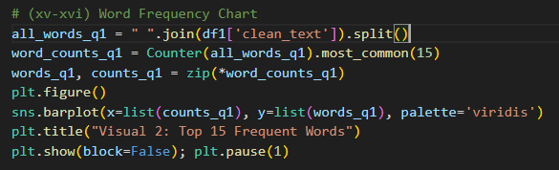
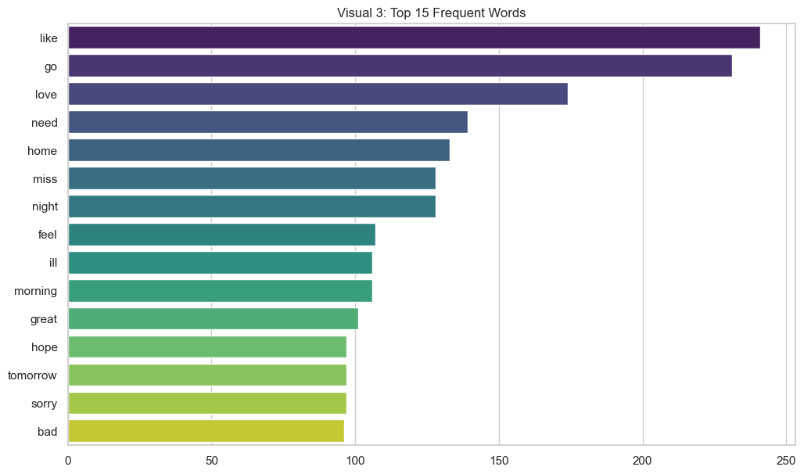
Word Analysis
Frequent Words Chart
The frequent words chart displays the most common terms after cleaning, revealing dominant themes within the dataset. It also confirms that preprocessing successfully removed irrelevant words, leaving only meaningful vocabulary for analysis.

Slide 9
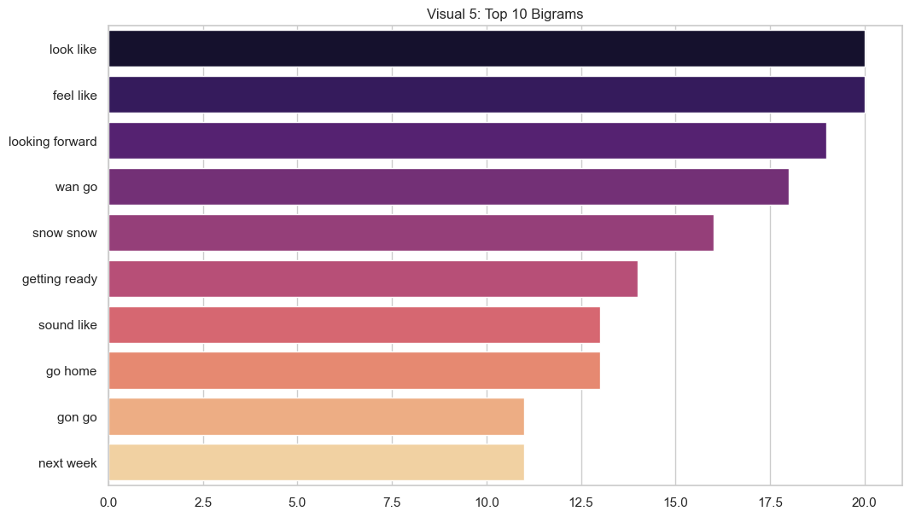
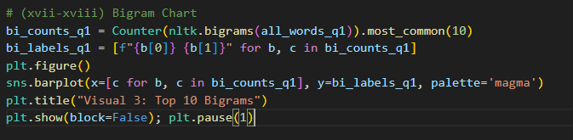
Bigram Analysis
Bigram Chart
The bigram analysis presents the most common word pairs, capturing context better than single words. This is important for sentiment analysis, as meaning is often conveyed through phrases rather than individual terms.

Slide 10
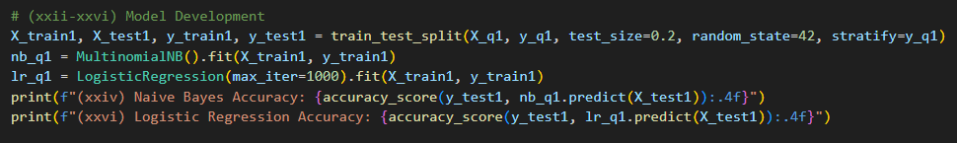
Feature Engineering & Models
Text converted into numerical features using TF-IDF.
Two models trained:
Naïve Bayes → fast baseline model
Logistic Regression → captures word relationships
Dataset split:
80% training
20% testing

Slide 11
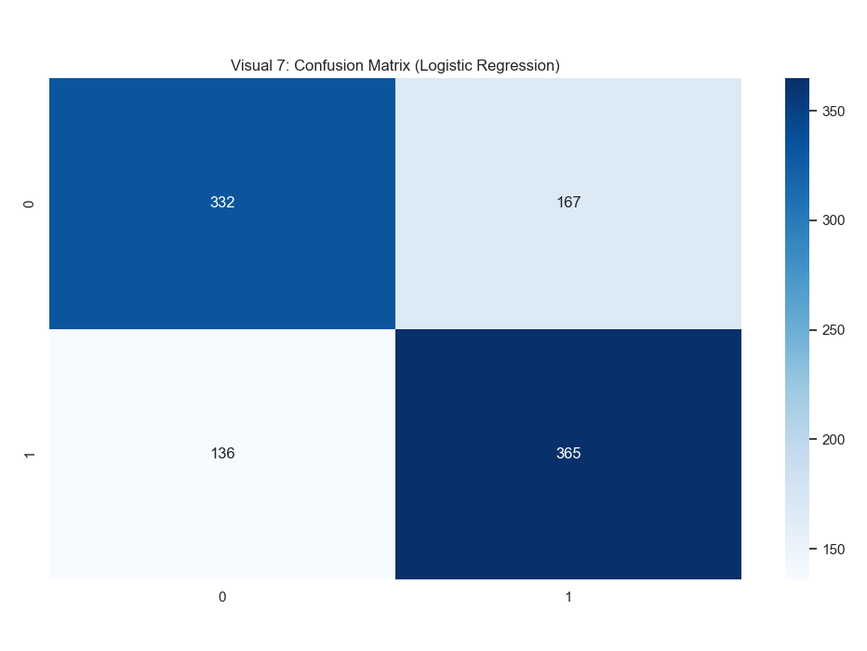
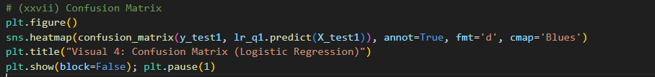
Models Evaluation
Confusion Matrix
Results
Logistic Regression achieved better accuracy.
Strong diagonal values show correct classification.
Reason: Logistic Regression handles feature relationships better.

Slide 12
2. TOPIC CLUSTERING
Clustering Approach
Goal: Automatically group news articles into topics.
Steps performed:
Preprocess news text
Convert text to TF-IDF features
Apply K-Means clustering
Use PCA for visualization
This enables unsupervised topic discovery.

Slide 13
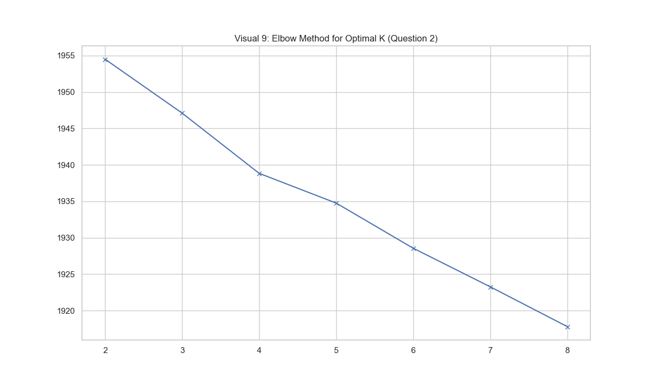
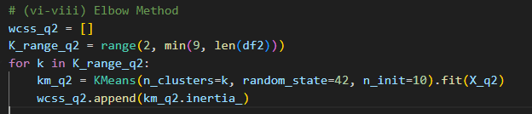
Clustering Results
Elbow Method Graph
The Elbow Method helps determine the most appropriate number of clusters by analyzing how clustering error decreases as the number of clusters increases.

Slide 14
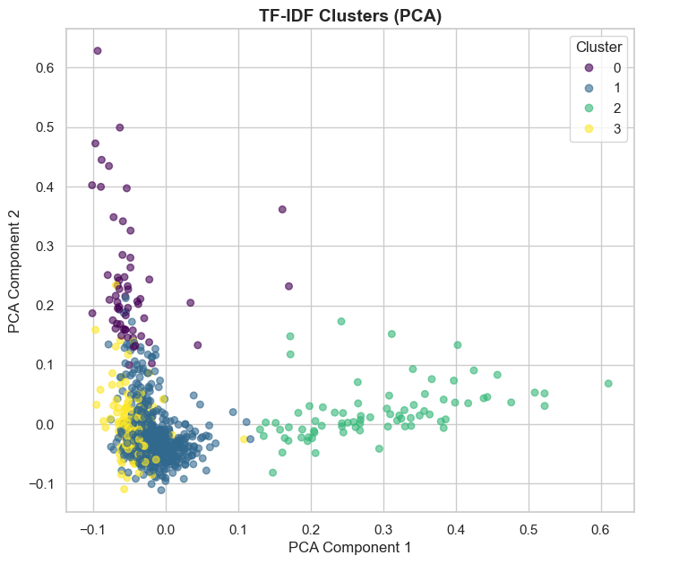
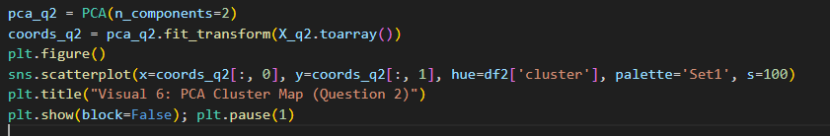
Clustering Results
PCA Cluster Scatter Plot
Insights
Optimal clusters determined as K = 4.
PCA shows clear separation between clusters.
Top keywords used to interpret each topic.
The PCA scatter plot visualizes the clustered data in two dimensions, with each point representing a document and colors indicating cluster membership. Clear separation between clusters suggests that the model effectively grouped similar texts together.

Slide 15
Sentiment Conclusion
This project demonstrated a complete NLP pipeline for analysing unstructured text.
Logistic Regression performed best for sentiment classification after effective preprocessing and TF-IDF feature engineering, while K-Means successfully grouped news articles into meaningful topics.
Overall, the work shows how NLP techniques can turn large text datasets into useful insights for real-world decision making.

Slide 16
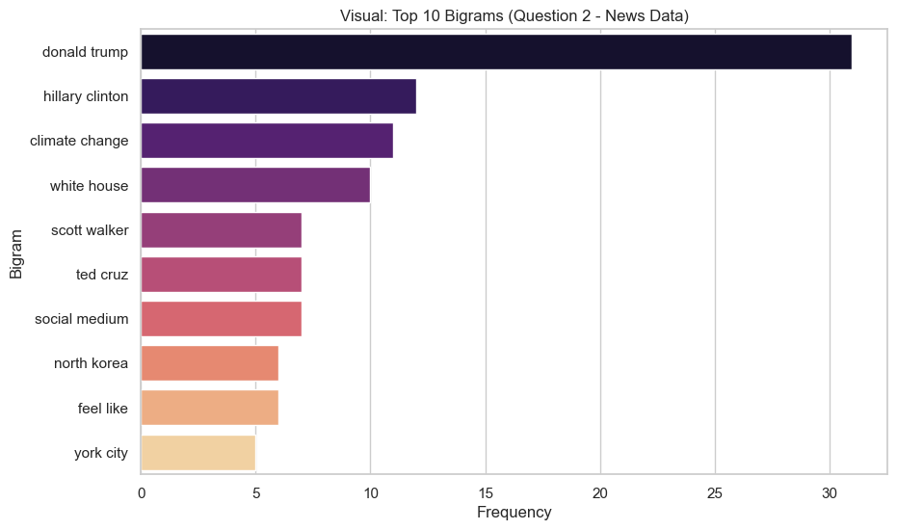
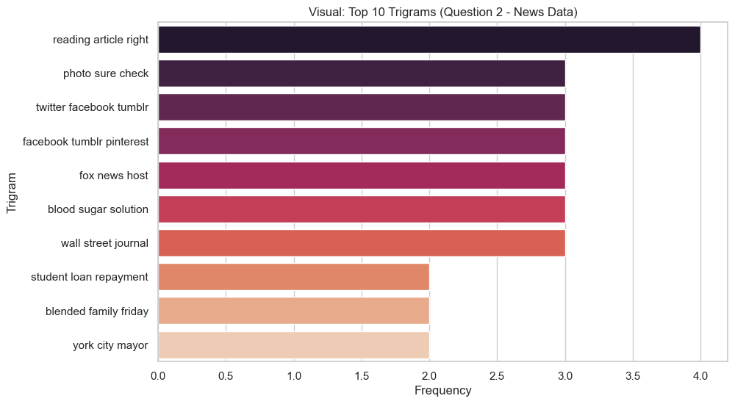
Q2 NLP Exploration: Bigrams & Trigrams
The bigram and trigram analysis for the topic clustering dataset reveals the most common word pairs and triplets, helping to identify multi-word topics such as 'donald trump' or 'york city mayor'.

Slide 17
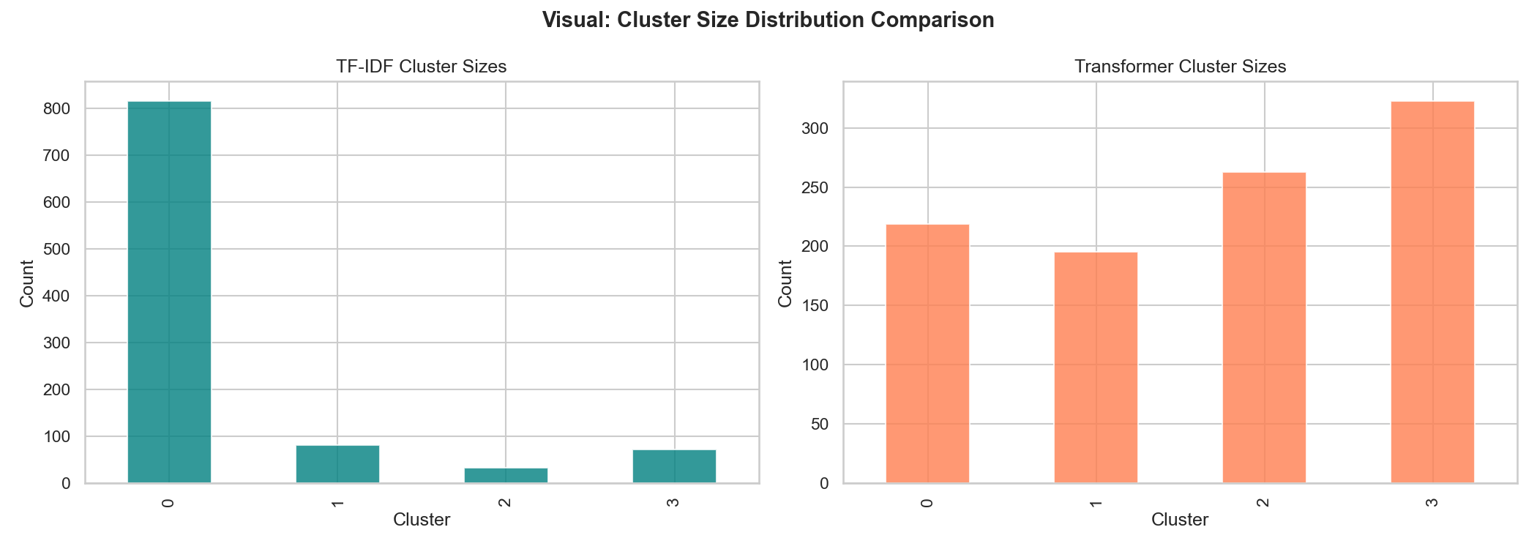
TF-IDF vs Transformer Cluster Comparison
The visual compares the clusters obtained using TF-IDF features versus Transformer Embeddings. Transformers capture semantic meaning beyond keywords, grouping documents differently when topics share vocabulary but differ in context.

Slide 18
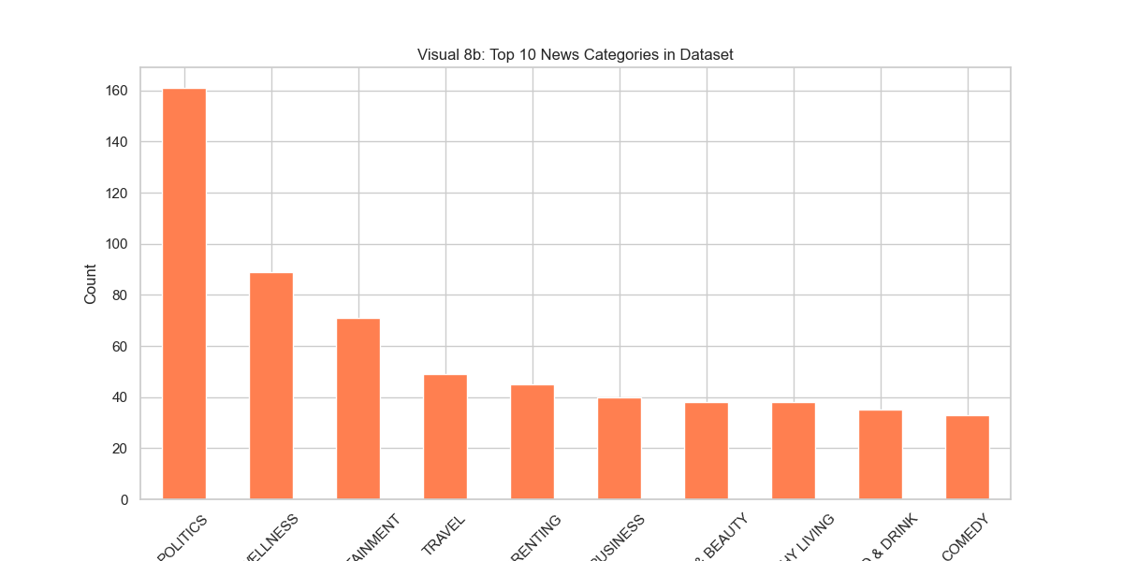
Category Distribution
This chart shows the distribution of news categories in the dataset. Understanding the distribution helps in identifying any class imbalance, which is crucial for evaluating clustering performance.

Slide 19
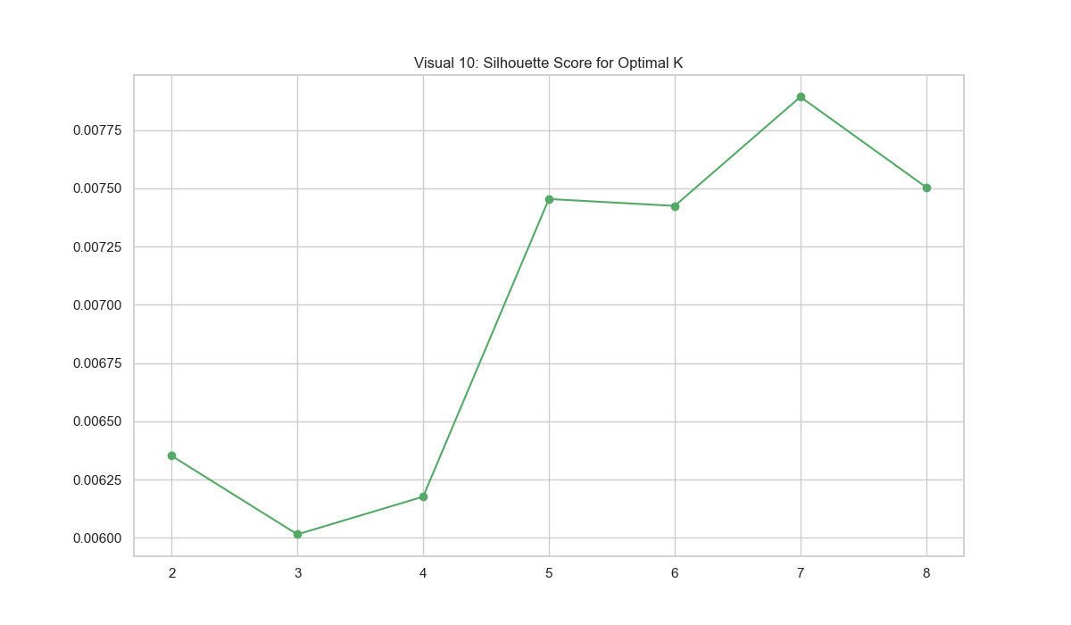
Silhouette Score
The Silhouette Score evaluates how well-defined the clusters are.
A higher score indicates that documents are closer to members of their own cluster and further from other clusters, helping to confirm the optimal number of clusters.

Slide 20
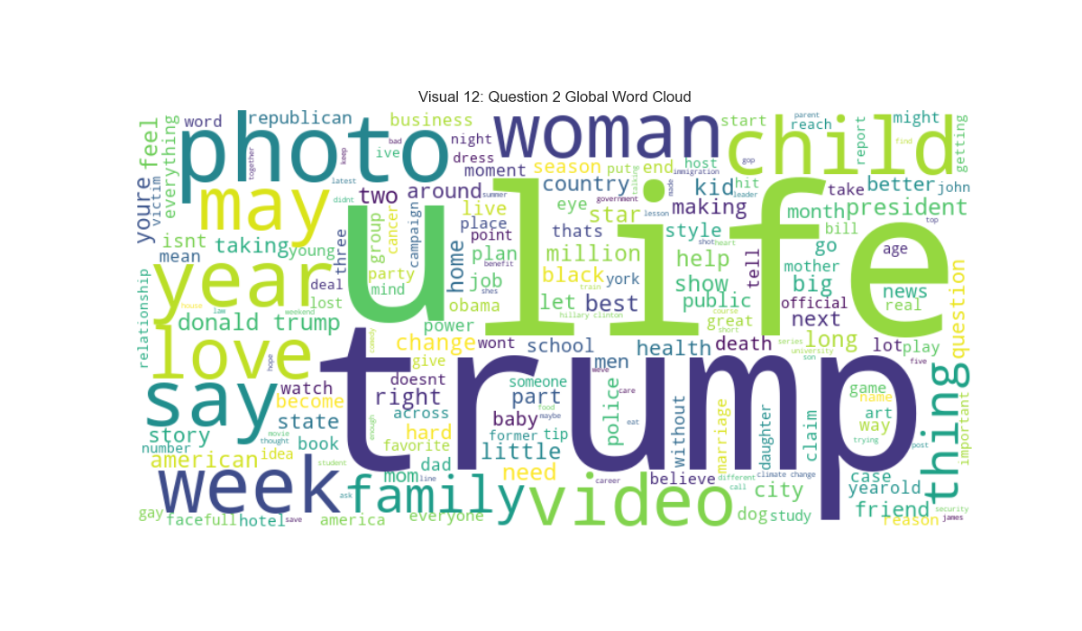
Global Word Cloud
The Global Word Cloud provides a visual summary of the most frequent words across the entire cleaned news dataset, offering a quick overview of the dominant topics.

Slide 21
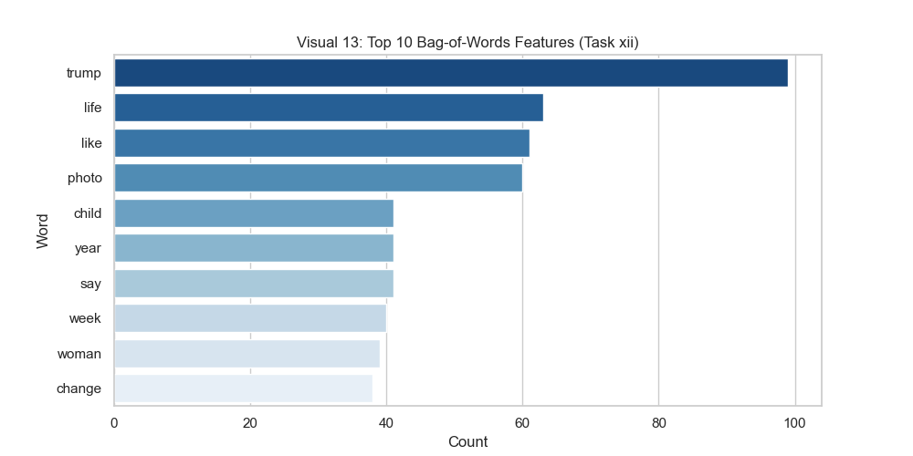
Bag-of-Words Features
Using the Bag-of-Words (BoW) approach, we extracted the top features based on raw word counts. This helps to identify the most common terms, although it may overemphasize frequent but less meaningful words.

Slide 22
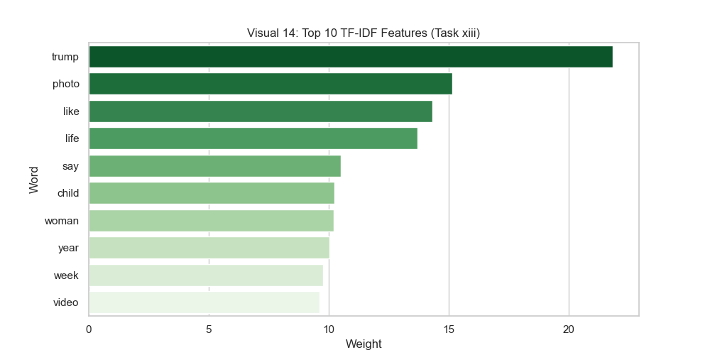
TF-IDF Features
The TF-IDF features weigh words based on their uniqueness across documents. Unlike BoW, TF-IDF effectively penalizes common words, allowing more distinct and topic-specific keywords to stand out.

Slide 23
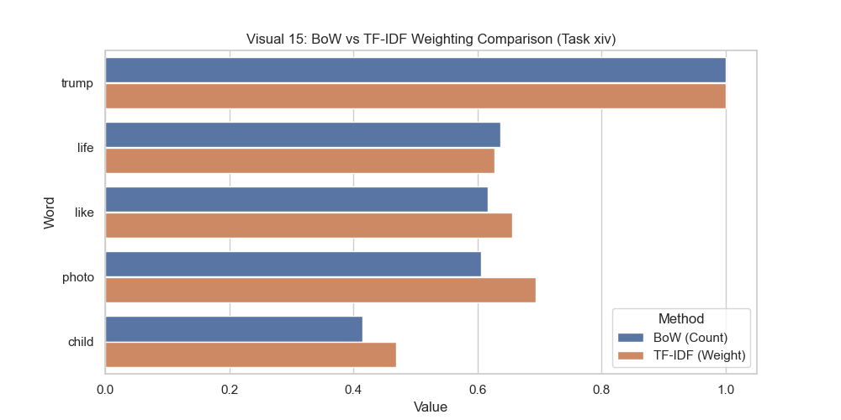
BoW vs TF-IDF Comparison
This comparison illustrates the difference between BoW counts and TF-IDF weights for the same words. It demonstrates how TF-IDF provides a more refined text representation.

Slide 24
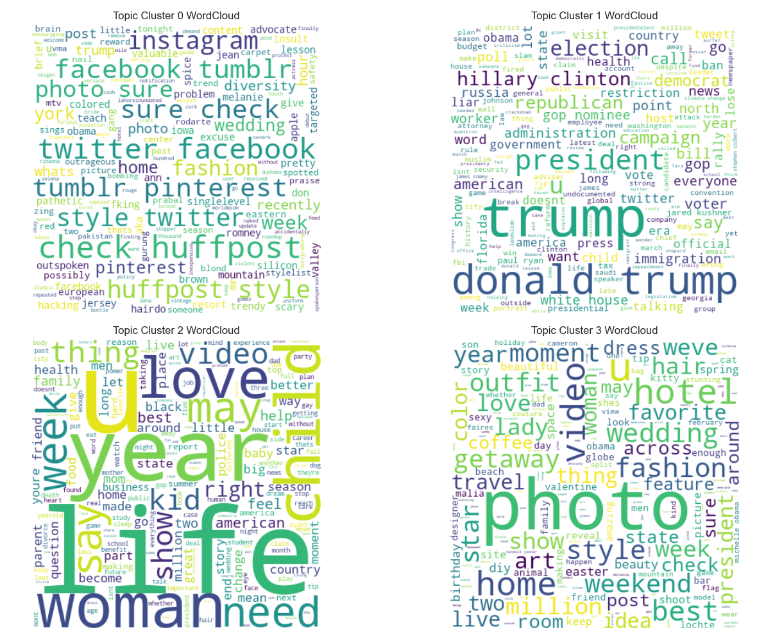
Topic Word Clouds
These word clouds are generated for each individual cluster.
They allow us to interpret the specific themes and subjects captured by the K-Means clustering algorithm based on the most prominent words in each group.

Slide 25
Final Conclusion: Clustering Quality
TF-IDF Approach:
Highly interpretable & computationally efficient
Effective for keyword-driven topics
Struggles with synonymy, polysemy, and sparse representation
Transformer Embeddings:
Captures deep semantic meaning & handles context better
Dense representations naturally capture similarities
Less interpretable & computationally expensive

